Slide 1
Analyzing Social Media Sentiment: Trends in Public Opinion Over Time
By Team Avengers
Likhitha Gade
Hari Chandana Mukkamala Chiranjeevi Uppala
Reddy Krishna Reddy Yeddula

Slide 2
Introduction
Project Title: Analyzing Social Media Sentiment: Trends in Public Opinion Over Time
Domain: Social Media Analytics
Objective: To track public sentiment on Twitter and identify trends over time.
Focus Case Study: Tesla Cybertruck window-breaking incident and United Airlines incident.

Slide 3
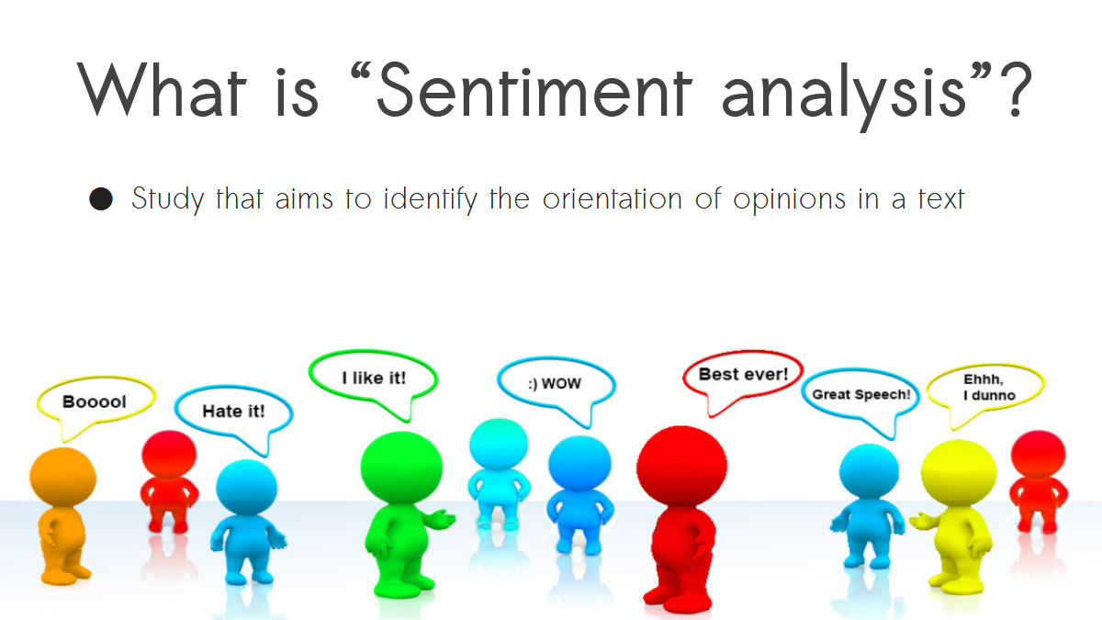

Slide 4
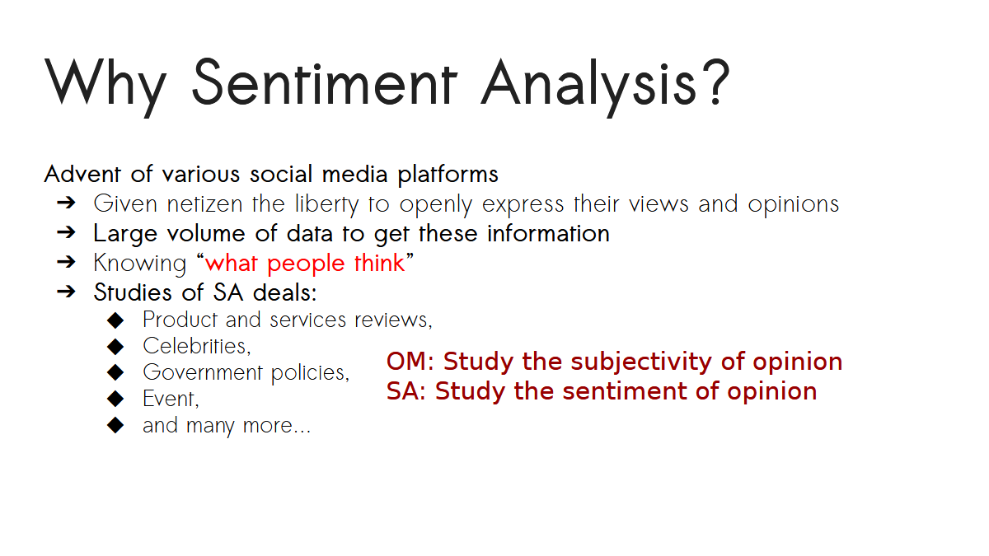

Slide 5
Problem Statement
Social media significantly impacts public opinion and brand identity.
Viral events can influence brand reputation positively or negatively.
Example: Cybertruck event started with negative sentiment but increased engagement.

Slide 6
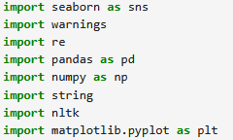
Libraries and modules used for project 1

Slide 7
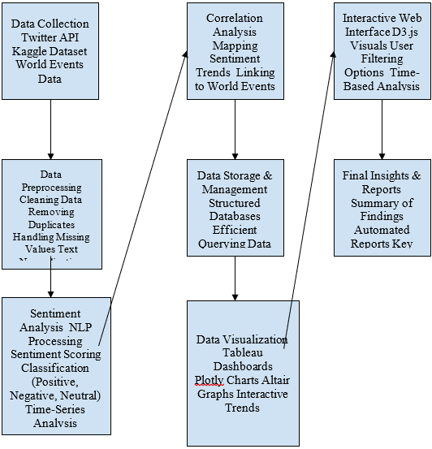
Workflow Diagram

Slide 8
Key Questions:
How did sentiment change before, during, and after the event?
What keywords and hashtags were most used?
Did the viral moment help Tesla's brand in the long run?
Role of memes in sentiment transformation.

Slide 9
Methodology
Workflow:Data Collection: Twitter sentiment dataset (Kaggle, UCI)
Preprocessing: Cleaning, filtering, handling missing values
Sentiment Analysis: Using NLP tools (VADER, TextBlob)
Visualization & Insights: Matplotlib, Seaborn, Scikit learn
Interpretation & Conclusion

Slide 10
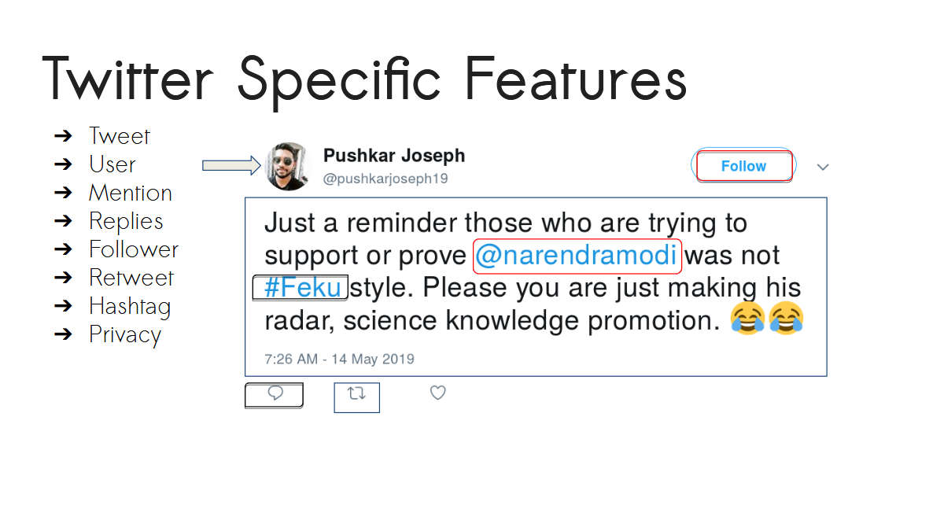

Slide 11
Data Abstraction
Dataset Details:
Structured CSV format
Train Dataset: 31,962 records, 3 columns (id, label, tweet)
Test Dataset: 17,187 records, 2 columns (id, tweet)
Data Source: Kaggle, UCI Machine Learning Repository

Slide 12
Data Transformation & PreprocessingCleaning
Removing special characters, emojis, URLs
Filtering: Retaining only English tweets
Handling Missing Values: Removing nulls, imputing missing timestamps
Outlier Removal: Filtering very short/duplicate tweets

Slide 13
Sentiment Analysis Methods
Lexicon-Based Approach: VADER, TextBlob
Machine Learning Models: Logistic Regression, Naive Bayes
Deep Learning: LSTMs for better sentiment classification

Slide 14
Case Study - Tesla Cybertruck Incident
What Happened?
Cybertruck’s armored glass broke during a live demo.
Initial reaction: Negative sentiment dominated Twitter.
Raw Sentiment Data Classification:
Negative Tweets: Backlash, disappointment, criticism
Neutral Tweets: News reports, general discussion
Positive Tweets: Humor, support for Tesla, memes

Slide 15
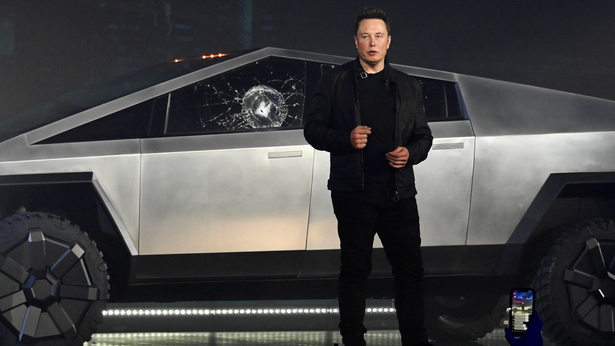

Slide 16
Sentiment Trends Over Time
Initial Reaction (Event Day):
Spike in negative words (“fail,” “embarrassing”).
High engagement in meme culture.
Turning Point (Following Days):
Elon Musk’s humor shifted perception.
Memes boosted Cybertruck’s visibility.
Long-Term Impact:
Increased pre-orders despite initial backlash.
Positive sentiment scores improved over weeks.

Slide 17
United Airlines Incident:
Viral video of a passenger being dragged off a plane in 2017. Massive public outrage, boycott calls, and stock price dip.
United Airlines PR Crisis:
Initial Reaction (Incident Day): Severe negative backlash with words like “boycott,” “horrific.”
Turning Point: Apology attempts initially failed but later damage control helped.
Long-Term Impact: Lasting reputation damage, but the brand recovered over time.

Slide 18
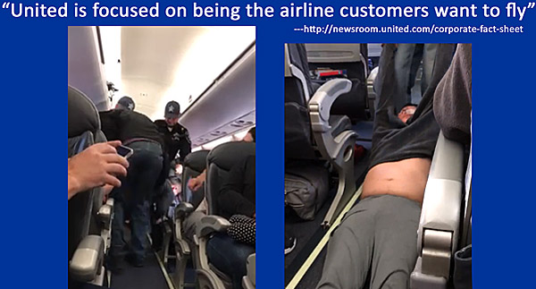

Slide 19
Key Insights & Conclusion
Viral incidents don’t always harm a brand—strategic response matters.
Social media sentiment can shift over time with humor & engagement.
Memes played a significant role in making Cybertruck a cultural icon.
Sentiment analysis can be applied to future PR crises and viral events.

Slide 20
Future Scope & Enhancements
Deep Learning Integration: Using BERT for better accuracy.
More Data Sources: Expanding beyond Twitter (Reddit, Facebook).
Real-Time Sentiment Tracking: Developing a live sentiment dashboard.

Slide 21
Responsibility Breakdown:
Team Member | Role & Responsibilities
Likhitha Gade | Data collection, preprocessing, and cleaning
Harichandana Mukkamala | Sentiment analysis and implementation of classification models
Chiranjeevi Uppala | Data visualization (Scikit Learn, Jupyter Notebook, Matplotlib)
Reddy Krishna Reddy Yeddula | Documentation, report writing, and final project presentation

Slide 22
Thank You!
LIKHITHA GADE
HARICHANDANA MUKKAMALA
CHIRAJEEVI UPPALA
REDDY KRISHNA REDDY YEDDULA

